Slide 1
Online support – VF – Fixed NBN
Background As part of the current Fixed Rapid Action working group, we’ve identified an opportunity to improve the top online support articles for NBN, to improve CX, reduce the need to contact and therefore potential subsequent churn. Cross-functional service blueprinting is underway for VF NBN activation journeys. This is an opportunity to review online support content in context of the wider journey like SMS/emails/collateral that direct customers to online support and ensure messaging accuracy and consistency. There are currently differences in online support content between brands examples next page) and ideally the copy and presentation should be optimised for common products and service needs across brands. Incremental improvements for VF brand can be reused for DFA when migrating to AEM. | Problem statement Current state challenges with VF NBN online support content includes: Too much content on single page Heavy use of acronyms or internal language that doesn’t match what the customer sees. E.g. Vodafone Wifi Hub 3 vs. Netcomm Inconsistent use of photos to help customers identify their modem type and follow instructions Top volume NBN support content pages: https://www.vodafone.com.au/support/home-internet/nbn-troubleshooting https://www.vodafone.com.au/support/home-internet/nbn-modems https://www.vodafone.com.au/support/home-internet/change-address www.vodafone.com.au/support/home-internet https://www.vodafone.com.au/support/home-internet/nbn-speed-guide ( More links in next slides)
Recommendation To optimise online support content across 3 phases. This request is to focus on Phase 1 to enable quick wins as part of the Fixed Rapid Action working group, requesting improvements within weeks. | Support requested Digital copywriter Producer Request of reference document or walkthrough of AEM page content design patterns and limitations | Working group members CX & Platform Strategy: Divya CX Ops Design & Delivery: Chad, Ryan, Marc Fixed Product: Blesson, Gina Fixed Devices: Dan Digital: TBC Legal: TBC
Phase 1
Phase 2
Phase 3
Update support content hierarchy (e.g page structure for different modems), review copy and insert images/videos where relevant and feasible, taking learnings of what works well in TPG and iiNet.
Undertake discovery of including competitor analysis and UX research/testing of online content layout e.g. step by step guides with focus on visual cues (like devices.vodafone.com.au)
Review findability through search and consider when/how to steer customers to logged in state OneApp for setup & install guides, with context of which modem & plan they’re on.
Explore leveraging tobi as hero contact channel to drive triage and decision tree to lead customer to relevant content quicker.
Creation of new video content.

Slide 2
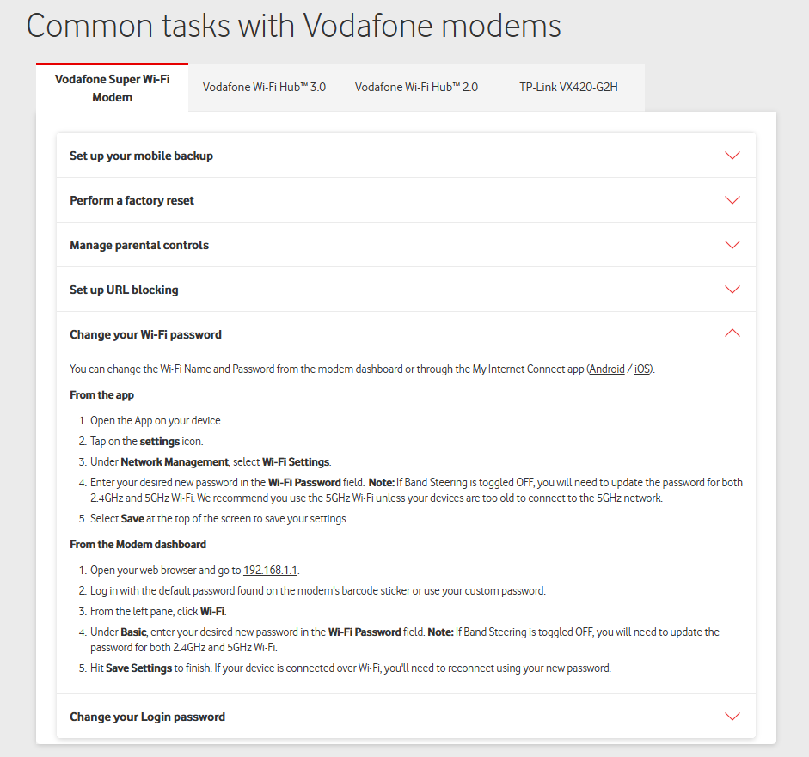
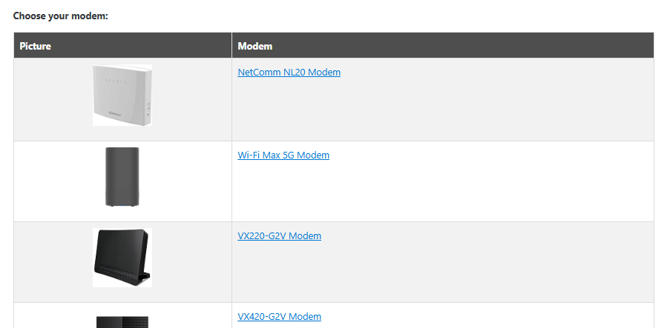
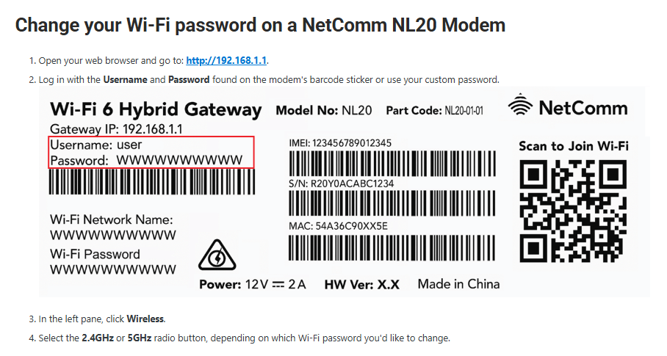
EXAMPLEs
Modem setup
Mobile responsive
No images of modem or other supporting imagery
Images of modem so customers can identify which one they have and what to look for
Plugin steps broken down across multiple sections.
Each page accompanied by a diagram showing only the cable relevant to the plugin step.
Easier for customer to follow process and navigate to right step
Before
After
https://support.tpg.com.au/how-change-your-wi-fi-password-tpg-modem

Slide 3
Page details
NBN supported content pages
# | Page Name | Link | Views in last 75 days
1. | Installation | https://www.vodafone.com.au/support/home-internet/nbn-installation | 4921
2. | NBN AVC ID | https://www.vodafone.com.au/support/home-internet/nbn-avc-id | 763
3. | Set up Modem | https://www.vodafone.com.au/support/home-internet/nbn-modems | 67760
4. | Compatible Modem(BYO) | https://www.vodafone.com.au/support/home-internet/nbn-compatible-modem
5. | NBN Troubleshooting | https://www.vodafone.com.au/support/home-internet/nbn-troubleshooting | 18750
6. | Speed guide Maximize your speed | https://www.vodafone.com.au/support/home-internet/nbn-speed-guide https://www.vodafone.com.au/support/device/maximise-wifi-speeds-at-home | 2481
7. | NBN Fiber upgrade | https://www.vodafone.com.au/support/nbn/fibre-upgrade | 16983
8. | Move Home/Change address | https://www.vodafone.com.au/support/home-internet/change-address | 7459
9. | NBN offline | https://www.vodafone.com.au/support/home-internet/nbn-offline?tabs=nbn | 7739
10. | Information, Main page | https://www.vodafone.com.au/support/home-internet/nbn-connections www.vodafone.com.au/support/home-internet www.vodafone.com.au/support | 118438
Reference pages :
https://support.tpg.com.au/troubleshoot-no-connection-your-nbn-fttc
https://support.tpg.com.au/set-your-nbn-fttbn
https://devices.vodafone.com.au/apple/iphone-17-ios-26/getting-started/activate-your-phone/

Slide 4
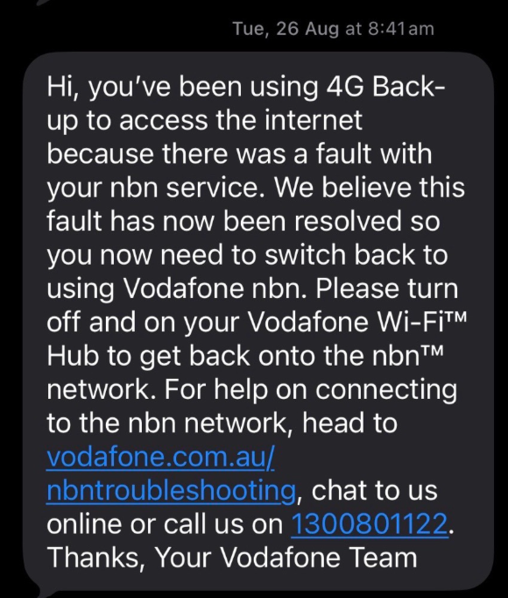
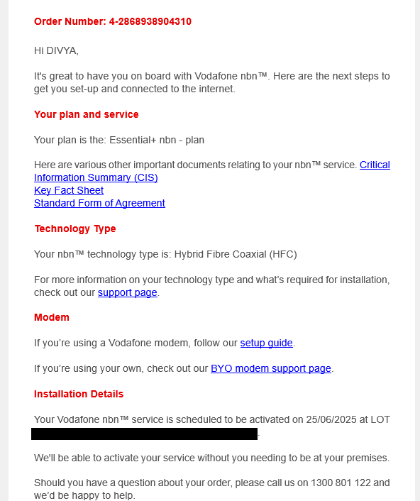

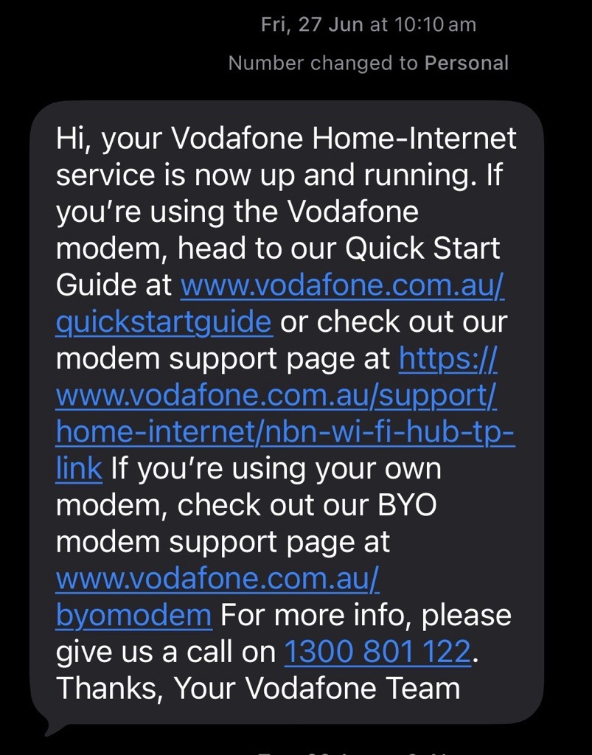
Comms
Comms showcasing support links
Email & SMS

